Slide 1
MAT 350 Engineering mathematics
Higher Order ODEs with
Variable Coefficient:
Cauchy-Euler Equation
Lecture: 8
Dr. M. Sahadet Hossain (Mth)
Professor
Department of Mathematics and Physics, NSU.

Slide 2


Cauchy-Euler Equation
A linear differential equation of the form
(1)
is known as a Cauchy-Euler equation.
Higher Order ODE
The differential equation is named in honor of two of the most prolife mathematicians of all time. Augustin-Louis Cauchy (French, 1789–1857) and Leonhard Euler (Swiss, 1707–1783).
The above equation (1) is also know as differential equation of variable coefficients.

Slide 3




Consider the 2nd order form for simplicity,
(2)
Method of Solution: We try a solution of the form

Slide 4




Auxiliary equation
There are three different cases to be considered, depending on whether the roots of this quadratic equation are real and distinct, real and equal, or complex.
Let m₁ and m₂ denote the real roots of (2) such that m₁ ≠ m₂.
The general solution is:

Slide 5



If the roots of (2) are repeated (that is, m₁= m₂), then we obtain only one solution —namely
The general solution is:

Slide 7

Solution methods:
Variation of parameters
(b) Changing to constant coefficients
Solution: First solve
0 for the Auxiliary equation.
We substitute
Hence, we have

Slide 8
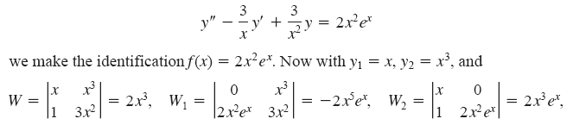


Slide 9









Exercise 4.7
u₂

Slide 10

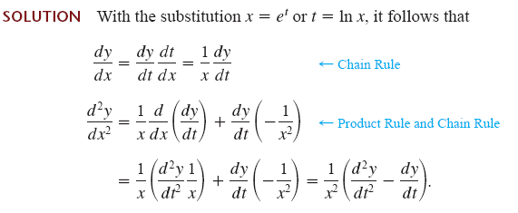


Slide 11

inf

Slide 12

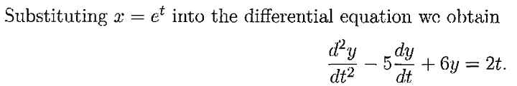


Using Superposition principle

Slide 13
Exercise: 4.7 Page-168
#11,16,19,22,24,25,26,30,33,34

